Slide 1
Parts Traceability Concept and Requests for GENPO
For GENPO
2025/4/17
Part Traceability Development Project

Slide 3
Agenda
Our Approach Towards Traceability Realization
The Purpose of Parts Traceability
Traceability System To-Be Image
Approach and Roadmap
Training Application Image
How to Manage Tracing Parts
Business Operation Requirements
Overview
S/N Management
Shelf-Life Management
Material Master Management
Notes:
ここに、新たに寿命管理を（特に校正をする手順）新たに行う現法に対して、寿命管理のやり方/手順/注意点についても伝えていく必要がある (今管理している手順書等をだれが持ってるのか調べる必要がある)
・・・IS山本さんエスカレーション

Slide 4
Concept and Roadmap

Slide 5
Purpose of Parts Traceability
To achieve a higher level of quality assurance by organizing a parts traceability scheme
We consider parts and product traceability as an essential part of our social responsibility
Goal
Theme
Initiative
Aim
Value
1
Faster Response to Quality Issues
1. Understand the current status/situation of parts
Trace the parts using S/N from incoming through scrap
Quickly understand the latest status of parts
Higher utilization rate
Higher customer satisfaction
2. Identify equipment which FCN/SI part is installed
Pinpoint affected equipment of trouble parts
Higher utilization rate
3. Respond to customer inquiries quicker
Provide part inspection data quickly when requested by customers
Higher customer satisfaction
4. Analyze causes of trouble
Compare part inspection data and perform correlation analysis between defected part and non-defected parts
Higher utilization rate
Higher productivity & yield rate
Reduction of quality follow-on cost
Lower quality variation among products
Higher competitive capability & product differentiation of supplier by improving part quality
High-Level Product Quality Assurance
2
Improvement of Design & Development
5. Analyze tool-to-tool & chamber-to-chamber matching
Compare inspection data and perform correlation analysis between tools or chambers
6. Analyze the condition of equipment
Compare and analyze the change in condition of equipment over time, and identify parts that affect equipment condition
7. Analyze the frequency of part defects
Analyze the frequency of trouble, and improve the quality of parts that consistently cause trouble
3
Improvement of Shelf-life Management Parts
8. Manage shelf-life of parts
Accurately manage the shelf-life of parts, and prevent shipment of expired materials
Dispose expired materials when managing inventory
Higher utilization rate

Slide 6
What Can be Achieved through Traceability System
Compliance
Compliance with ISO requirements
In accordance with "ISO9001: Identification and Traceability, Clause 8.5.2," we will more accurately and quickly grasp the origin, identification, and status of the equipment we sell.
Compliance with Laws and Regulations
Accurately and quickly identify regulatory compliant (or non-compliant) items by part serial number or batch number
Response to the semiconductor industry
Addressing industry and customer needs to ensure traceability in the semiconductor supply chain (traceability labels & data requirements)
Quality
Location of trouble parts
Quickly identify the location of FCN/SI and recalled items by part SN or batch number
Trouble analysis (part inspection data)
Quickly extract supplier inspection data for specific individual parts for analysis
Trouble analysis (individual part history)
Quickly understand the history of a specific part
Trouble analysis (composite analysis)
By comparing traceability data (※), possible causes of defects can be identified.
*Defect data, work history data, inspection data, etc.
Proactive trouble prevention
Identify risk parts that are reaching the end of their shelf life and prevent them from being shipped
Respond to customer needs
Providing CoA data per part serial number enables quicker response to customer needs for data-driven reduction of equipment downtime
Efficiency
Operational efficiency
Enabling one-stop access to information on shipped parts and equipment

Slide 7







Traceability System (To-Be Image)
Flow of goods
Data flow
Application
FCN・SI
Parts
tracking
Parts
Shelf-life Management
Part inspection data extraction
Tool-to-Tool data analysis
Data Utilization Platform
Traceability Data Mart
Data Infrastructure
IPDB
SAP
JOE
SCM
WMS
MES
Merit
Service CRM
DCS
Customer Data
Parts Inspection Data
Parts production data
Production Environment Data
Equipment Inspection Data
Device
Parameters
Part S/N
Equipment Production Data
S-UP Data
Operation Data
Maintenance Data
Defect Data
Part S/N
Part S/N
Assembly Supplier
Part Supplier
TEL
Customer FAB
Manufacturing
inspection
Parts replacement
Manufacturing
inspection
Arrival
assembly
inspection
shipping
Delivery
S-UP
Operation
Maintenance
Delivery
Change
Operation
Parts Information
Equipment Production Information
Operational Information

Slide 8
Steps to Achieving Traceability
We’re here!
G1P & MES implementation
ServiceCRM Integration
Tool configuration data linkage
Equipment configuration and malfunction data linkage
Customer tool operation data linkage
Value
&
Function
Step3 Full-Scale
Tool-to-tool comparison and analysis support (TBD)
Step3 SmallStart (Trial)
Tool-to-tool comparison and analysis support
Step2
Understand service work history and parts replacement history
Step1
Parts location tracking, inspection data and manufacturing work history, shelf-life management
Step0
Automatic collection of part inspection data
Time

Slide 9
Parts Traceability Roadmap (Revised 2025/01/17)
TODAY
 | FY2021 |  | FY2022 |  | FY2023 |  | FY2024 |  | FY2025 |  | FY2026 |  | FY2027 |  | FY2028
 | 1H | 2H | 1H | 2H | 1H | 2H | 1H | 2H | 1H | 2H | 1H | 2H | 1H | 2H | 1H | 2H
G1P Milestones
MES Milestones
Traceability Step
1. Collect data SAP-based Business Operations
❷ Utilize data Application Development
R2
EWM
R2
TEA
R3
TML
R6
TET
R8
TEE
R10
TEK
TES
TMEA
R1
R5
TKL
R6
TSI/TMY
R7
TTS
TML
TKL
TTS
Step 1: Parts location tracking, inspection data and manufacturing work history, shelf-life management
Step 2: Understand service work history and parts replacement history
Step 3: Tool-to-tool comparison and analysis support
Start of business operations
Preparation
Parts S/N & batch management
Domestic Spare Parts
R2 EWM
US Spare Parts
R2 TEA
TML spare parts & equipment built-in parts
R3TML
TKL Spare Parts & Equipment Built-in Parts
R5 TKL
Overseas spare parts
R6/8 Genpo
R7 TTS
Shelf Life Management
TEL/TEA/TML inventory inspection/life check
R3 TML
TKL inventory inspection/life check
R5 TKL
TTS inventory inspection and life check
R6/8 Genpo
R7 TTS
Scheduled for release with requirements definition & implemented features
Initially, it was expected to be operational in R3, so it was limited to TML/ES part data tracing.
Replanning
Under “Product Governance Operation DX Project”
Requirement definition
2025/12
release※
1st release development
(TML/ES related system integration)
Pending
1st release test
By 2026 (TBD)
release※
2nd release requirements definition
2nd Release
Basic design and implementation
App deployment
Consider
The schedule will be revised after defining additional requirements such as compliance and connection to bases other than TML.

Slide 10
Step 1/2 Traceability System Collaboration Overview
Step1
Step2
Step3
① Collection (EAI/ETL)
②Storage (DWH)
③ Inquiry (Parts Traceability System)
It is expected that data required for traceability will be collected from multiple data source systems into the GMX container, ADP data lake, and production container.
The information collected in each container is expected to be stored in a form that can be searched using a traceability inquiry app.
Any information that falls outside the data retention period specified by the main purpose of each container will be stored in a long-term storage container.
Build reports to check part history from various traceability data
It also supports operations such as deriving part history from device configuration and tracking changes in part S/N.
collection
Factory SAP
/IPDB
Parts Item Code Information
Assy item code information
Traceability flag 5 items
Parts master information
Store
Traceability Data
inquiry
Traceability System (app)
GMX
*Green text: Obtained via GMX
Traceability
Data Mart
FCN/SI parts
Tracking
Inquiry parts inspection result processing
WISDOM
parts
Lifespan Management
Machine difference
trouble
Equipment Master Information
Equipment history
(Relocation, decommissioning, etc.)
Merit21
Device configuration
Link reference
Factory equipment production results
Factory parts/assembly production record
Assy supplier production performance
Factory equipment shipment record
Factory parts/assembly shipment record
Factory parts/assembly inventory record
Factory parts/assembly disposal record
Factory parts/assembly acceptance inspection results
Factory parts/Assy/Equipment inventory information
Factory parts/assembly shipment record
Factory parts/assembly inventory record
Factory parts/Assy stock
Narita Parts/Assy Shipment Record
Narita Parts/Assy Stock Information
Trouble information (supplier)
Trouble information (factory)
Trouble information (after shipment from factory)
Factory equipment production results
Factory parts/assembly production record
Assy supplier production performance
Parts/Assy disposal record during manufacturing
Factory parts/assembly in-process inspection results
Factory parts/assembly pre-shipment inspection results
Factory equipment in-process inspection results
SCM
(Specially selected)
Genpo parts/assembly shipment record
Genpo parts/Assy disposal record
Deposit parts/Assy inventory information
Supplier Rework Track Record
Supplier Repair Track Record
Supplier overhaul track record
Factory rework results
Factory repair record
Factory overhaul record
Parts S/N change record
Parts assembly performance
Parts removal record
Assy assembly performance
Assy removal record
*FE customer work track record
QVICS-i
Supplier Information
Parts Inspection Results
Assy inspection results
WMS
Each factory
MES
(3 systems)
SAP MM
SAP(MM)
TEXAS
DB (3 systems)
BaaN
(Historical data)
Each factory
Local system (8 systems)
EWM
EWM
TBD
(SAP/SMARTS
etc. under consideration)
Service
CRM
TELe Search

Slide 11
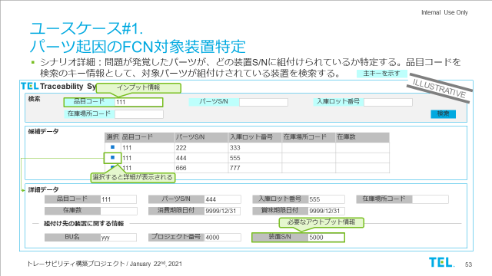
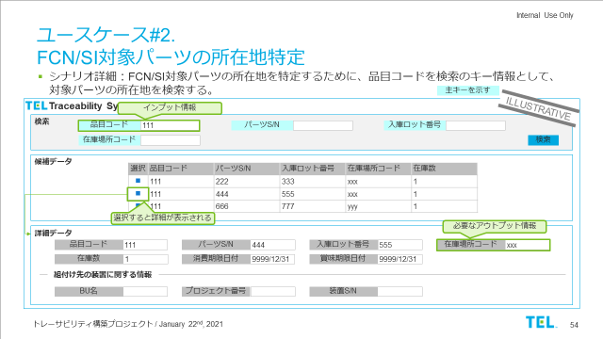
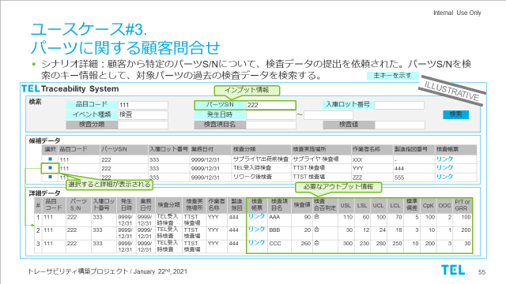
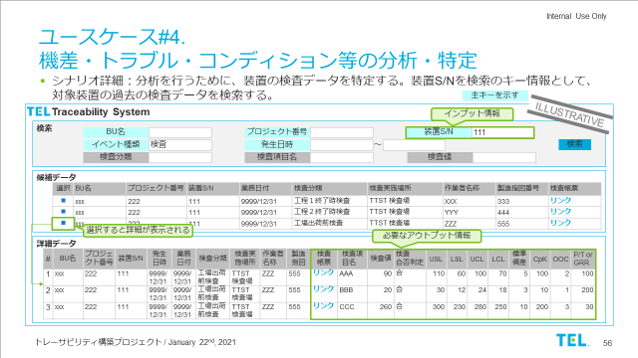
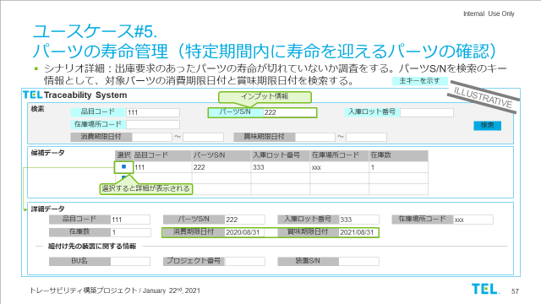
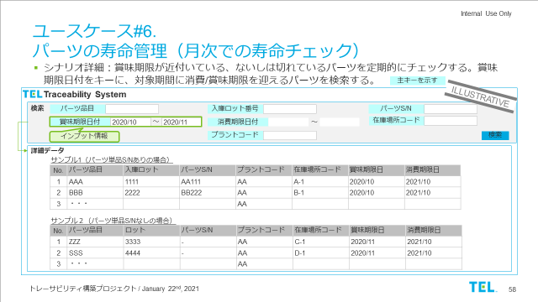
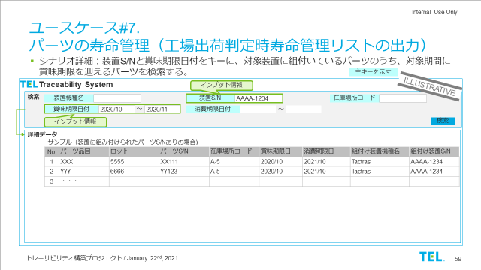
Traceability System(Tracing App) Themes to be Covered
Step1
Step2
Step3
Goal
Theme
Initiative
Use Cases(Tracing App Screen)
1
Faster Response to Quality Issues
1. Understand the current status/situation of parts
1
Identifying equipment subject to FCN (traceable to parts)
Find out which parts are installed to which equipment, by tracking S/N
2. Identify equipment which FCN/SI part is installed
2
Identifying whereabouts of parts subject to FCN/SI
Find out where the FCN/SI parts are currently being used
3. Respond to customer inquiries quicker
3
Responding to customer inquiries regarding parts
Look up information about parts requested by the customer
4. Analyze causes of trouble
High-Level Product Quality Assurance
2
Improvement of Design & Development
5. Analyze tool-to-tool & chamber-to-chamber matching
4
Identifying and analyzing equipment variation, issues, conditions, etc.
Look up information about parts linked to specific equipment
6. Analyze the condition of equipment
5
Shelf-life Parts Mgmt. (Checking up on to-be expired parts during a certain period)
Look up shelf-life/best-before life about parts that have been requested for shipment
7. Analyze the frequency of part defects
6
Shelf-life Parts Mgmt. (Checking up on shelf-life/best-before date monthly)
Regularly check shelf-life/best-before life of inventory parts
3
Improvement of Shelf-life Management Parts
8. Manage shelf-life of parts
7
Shelf-life Parts Mgmt.
(Exporting a list of managed parts when preparing for shipment)
Check whether parts preparing for shipment is not expired

Slide 12
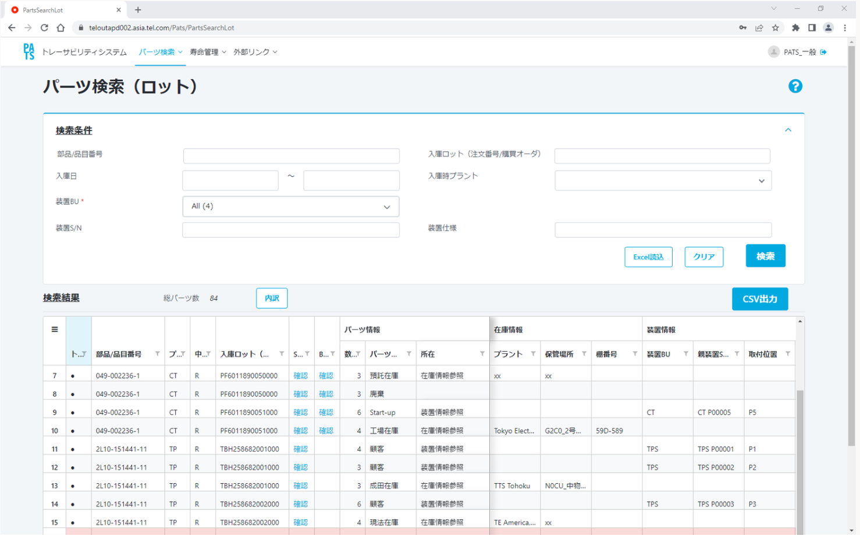
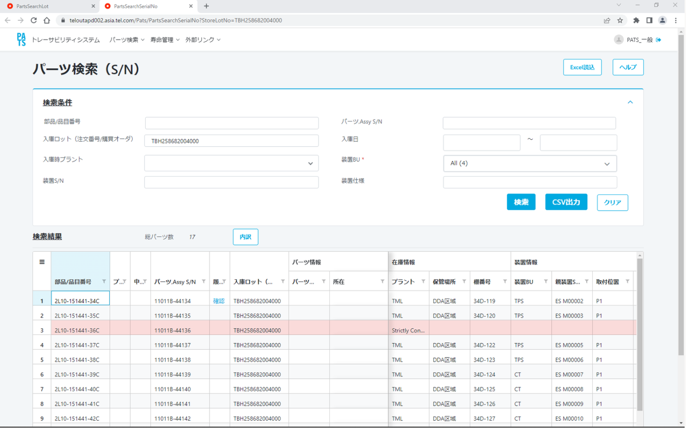
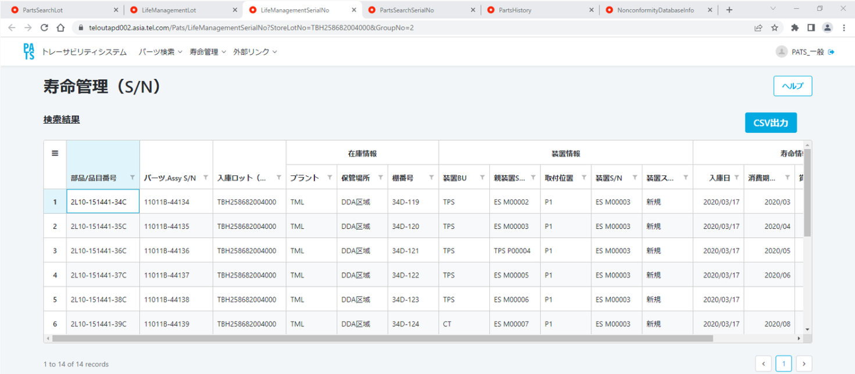
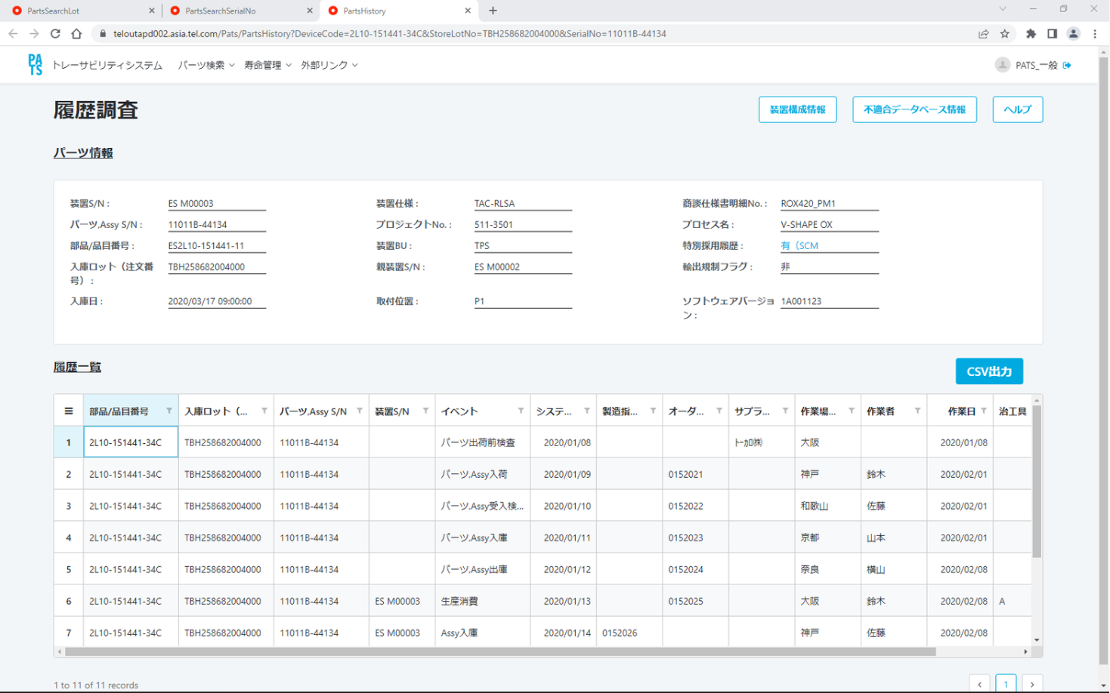
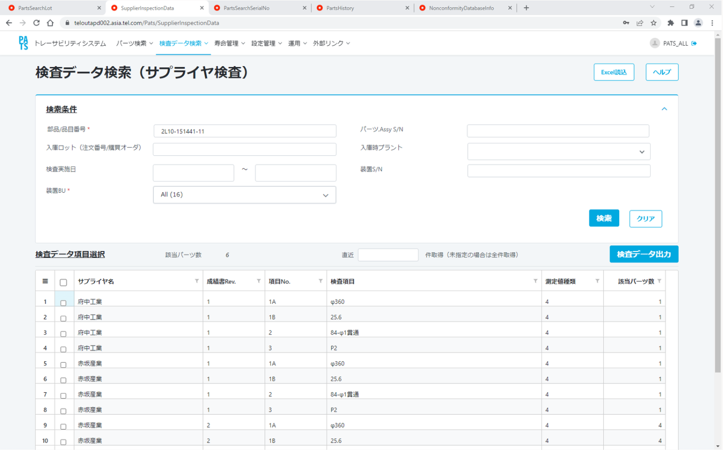
Step1
Step2
Step3
Step 1/2 Parts Traceability System Screen Image
SAMPLE

Slide 13
How to Manage Tracing Parts

Slide 14
What Kind of Parts Will be Traced (Overview)
To achieve traceability, we will manage the S/N and shelf-life/best-before life of individual parts
 | ①S/N Management | ②Perishable Parts Management
Overview | Managing the full history (manufacturing, purchasing, warehousing, assembling, operating etc.) of individual, critical parts. | Managing the shelf-life/best-before life (by month) of individual parts that deteriorate over time.
Purpose | To quickly collect and repair all parts that have an issue and determine the cause of trouble In order to accurately identify these parts, it is necessary to record information such inspection and adjustment data, and to track its history. | To prevent the shipment of parts that have deteriorated over time, and to perform proper asset valuation of our equipment/parts
Unit of Mgmt. | By parts S/N (By batch no. for parts that cannot be traced individually) | By batch no. (Batch number will be assigned at good receipt)
Selection Process | Decide which parts to trace upon consideration among the engineering dept. and factory QA
What to Manage | The following 2 categories of critical parts: ①Trouble Parts ②PCS (Process Control System) Parts | The following 2 types of dates: ①BBD (best-before date), which can be extended by overhauling, calibration, etc. ②SLED (shelf-life end date), which cannot be extended

Slide 15



How to Manage Tracing Parts
Indicators for the traceability target parts are set per part number.
As-Is
To-Be
Discretionary Tracing of Parts
One-TEL Standardized Policy
Parts#：2L10-123456-11
Spare Parts：ES2L10-123456-11
Shelf-life/best-before life & S/N management policies may differ depending on the location
Parts#：2L10-123456-11
Spare Parts：ES2L10-123456-11
QA Dept.
Sets the same shelf-life and S/N management policy for each part
Factory A
Shelf-life is 36 mths
Manages S/N
Factory A
Shelf-life is 36 mths
Manages S/N
Narita Warehouse
Shelf-life is 12 mths
Doesn’t manage S/N
FS
Doesn’t manage shelf-life
Manages S/N
Narita Warehouse
Shelf-life is 36 mths
Manages S/N
FS
Shelf-life is 36 mths
Manages S/N
Factory B
Shelf-life is 60 mths
Doesn’t manage S/N
Factory B
Shelf-life is 36 mths
Manages S/N
【Current Issues】
Serialization of parts based on ambiguous rules set at each BU
No communication present for setting shelf-life or best-before life among BUs/factories
【Expected Results】
One-TEL list declares serialization and shelf-life for each material
Consistent serialization across operations
Tracing of parts reflect QA requirements

Slide 16
How to Manage Tracing Parts
Indicators for the traceability target parts are set per part number.
As-Is
To-Be
Discretionary Tracing of Parts
One-TEL Standardized Policy
TEL Parts Traceability Management Using Traceability Flags
After the factory QA dept. decides the management policy for each part, that policy will be registered to SAP’s master data
We would like to ask for your cooperation to manage S/N and shelf-life/best-before life of parts based on SAP’s master data
Parts#：2L10-123456-11
Spare Parts：ES2L10-123456-11
Shelf-life/best-before date & S/N management policies may differ depending on the location
Parts#：2L10-123456-11
Spare Parts：ES2L10-123456-11
QA Dept.
Sets the same shelf-life and S/N management policy for each part
Factory A
Shelf-life is 36 mths
Manages S/N
Factory A
Shelf-life is 36 mths
Manages S/N
Narita Warehouse
Shelf-life is 12 mths
Doesn’t manage S/N
S/N Mgmt. Indicator：1
SLED：36
BBD：0
FS
Doesn’t manage shelf-life
Manages S/N
Narita Warehouse
Shelf-life is 36 mths
Manages S/N
FS
Shelf-life is 36 mths
Manages S/N
Factory B
Shelf-life is 60 mths
Doesn’t manage S/N
Factory B
Shelf-life is 36 mths
Manages S/N
Material Code：
2L10-123456-11
Factory SAP
TEL/GENPO
SAP
【Expected Results】
One-TEL list declares serialization and shelf-life for each material
Consistent serialization across operations
Tracing of parts reflect QA requirements
【Current Issues】
Serialization of parts based on ambiguous rules set at each BU
No communication present for setting shelf-life or best-before life
⇒

Slide 17
Business Operation Requirements

Slide 18

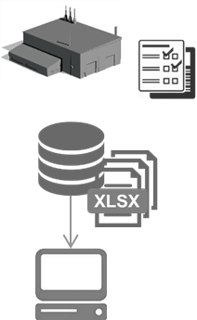



Overview of Operational Changes
Flow of Goods
Flow of Data
Parts Information
Equipment Production Information
Operation Information
TEL
Parts Supplier
TEL
Customer FAB
Parts Exchange
Develop/Design
Preparation
Production
Inspection
Ship In
Assembly
Inspection
Ship Out
Carry in
S-UP
Operation
Maintenance
Carry in
Exchange
Operation
Assembly Supplier
※Workload may increase or decrease depending on the number of serialized or shelf-life managed parts
Production
Inspection
Current Op.
New Op.
Current Op.
Current Op.
&Automation
Current Op.(※)
Who
Engineering Dept.
QA Dept.
Procurement Dept.
Supplier
Warehouse
(TELBP)
Production
Warehouse
(Factory/Narita/
Genpo/3PL)
Logistics
(TELBP
Genpo/3PL)
SUE
FSE
Automatic
B
A
What
New Material
Traceability Flag
C
Order
Parts
Inspection Data
Parts Shelf-Life
Parts S/N
(Assembly Work History)
Shelf-Life Check
(Inventory Management)
Parts S/N
(Spare Parts Shipment Record)
Parts S/N
(SU Work Record)
Parts S/N
(Exchange Record)
C
C
System
JOE/IPDB
SAP
SAP
SCM
WMS
MES
WMS
WMS
Service CRM
Service CRM
GMX
DCS
SAP
Merit
SAP/EWM
SAP/EWM
Merit
Merit
Data Containers
Traceability System
(Data tracing app)

Slide 19
Overview of Operational Changes
Traceability implementation will cause changes in S/N & parts shelf-life management operations
＃ | Operation | Changes in Operation
A | Logistics | Record the S/N for the spare parts specified by QA (serialized parts), which has the indicator in the system
B | Warehouse Management | Check the shelf-life/best-before life for inventory in accordance with the indicator set by QA factory (based on One-TEL guideline)
C | Material Master Management | Transfer S/N Management Indicator (SN Profile) and shelf-life months in the SAP material master to the 3PL system
Notes:
皆さまへの影響
パーツS/Nを記録したいです TML/TTS : MES稼働後MESで記録してね TKL：PMSで記録してね
記録対象は品証指定です ・記録対象をSAP品目マスタに登録=>各システム連携 ・件数は基本変わりません、後ほど詳細を・・・
トレサビフラグの精度向上 ・S/N刻印ない奴教えてね

Slide 20
(Recap) How to Manage Tracing Parts
Indicators for the traceability target parts are set per part number.
As-Is
To-Be
Discretionary Tracing of Parts
One-TEL Standardized Policy
TEL Parts Traceability Management Using Traceability Flags
After the factory QA dept. decides the management policy for each part, that policy will be registered to SAP’s master data
We would like to ask for your cooperation to manage S/N and shelf-life/best-before life of parts based on SAP’s master data
Parts#：2L10-123456-11
Spare Parts：ES2L10-123456-11
Shelf-life/best-before date & S/N management policies may differ depending on the location
Parts#：2L10-123456-11
Spare Parts：ES2L10-123456-11
QA Dept.
Sets the same shelf-life and S/N management policy for each part
Factory A
Shelf-life is 36 mths
Manages S/N
Factory A
Shelf-life is 36 mths
Manages S/N
Narita Warehouse
Shelf-life is 12 mths
Doesn’t manage S/N
S/N Mgmt. Indicator：1
SLED：36
BBD：0
FS
Doesn’t manage shelf-life
Manages S/N
Narita Warehouse
Shelf-life is 36 mths
Manages S/N
FS
Shelf-life is 36 mths
Manages S/N
Factory B
Shelf-life is 60 mths
Doesn’t manage S/N
Factory B
Shelf-life is 36 mths
Manages S/N
Material Code：
2L10-123456-11
Factory SAP
TEL/GENPO
SAP
【Expected Results】
One-TEL list declares serialization and shelf-life for each material
Consistent serialization across operations
Tracing of parts reflect QA requirements
【Current Issues】
Serialization of parts based on ambiguous rules set at each BU
No communication present for setting shelf-life or best-before life
⇒

Slide 21
A: Keeping Track of Spare Parts Subject to S/N Mgmt. (3PL)
Register the S/N information for the serialized parts
■Flow from Setting Traceability Indicators to Registering Spare Parts S/N to GENPO SAP/EWM
Legend
Process
System
Data
Factory QA
GENPO Logistics
3PL
System
Set traceability indicators
Check Parts Without S/N
Confirm Goods Received Record
Inform QA About Parts Without S/N
・Part Number
・BBD
・SLED
・S/N mgmt. indicator
・PCS mgmt. indicator
・Trouble mgmt. indicator
Request
Goods Received
Request to Input Parts S/N
N
Record Parts S/N
Set Dummy S/N (Unique #)
Inform GENPO About Parts Without S/N
Has
SN？
Y
Factory SAP
3PL System
Traceability System
GENPO SAP
・Part Number
・Parts S/N

Slide 22
B: Shelf-life Parts Mgmt. (3PL)
Check the shelf-life (SLED/BBD) of the inventory parts and take appropriate action for the parts that have expired.
■Flow from Setting Traceability Indicators to Checking Inventory
Legend
Process
System
Data
Factory QA
3PL
System
Set traceability indicators
Request
・Part Number
・# of Inventory
・BBD
・SLED
etc.
Export Inventory Report
Inventory Check (Check BBD & SLED)
Factory SAP
GENPO SAP
Notes:
皆さまへの影響
パーツS/Nを記録したいです TML/TTS : MES稼働後MESで記録してね TKL：PMSで記録してね
記録対象は品証指定です ・記録対象をSAP品目マスタに登録=>各システム連携 ・件数は基本変わりません、後ほど詳細を・・・
トレサビフラグの精度向上 ・S/N刻印ない奴教えてね

Slide 23
C: Traceability Indicators (SN Profile & Shelf-life) Linkage to 3PL system
Transfer S/N Management Indicator (SN Profile) in the SAP material master to the 3PL system. This also applies to the shelf-life months.
Org./Dept.
TEL | TEL Factory | QA
 | Inventory Mgmt. Locations (GENPO, 3PL)
 | System
Legend
WF
Start/End
Process
Judgment
System
Data
SAP Master Update – after notifying related departments
N
N
Identify parts
That require
Master update
Fill out info. For master update
Update SAP Material Master (MALSY)
Check for any open IBD/OBD orders
Request to
Close all
Open orders
Activate batch processing
Request to restart movement of goods
END
Any
Open
orders？
Movement
Stopped?
Y
Y
Open IBD/OBD Orders (Image) @ TEL/GENPO SAP
Date | WH_Code | Product Code | Lot No | Parts SN | Quantity
2021/4/7 | PO-0001 | 2L10-0001-V1 | Lot-001 | SN001 | 1
2021/4/7 | PO-0001 | 2L10-0001-V1 | Lot-001 | SN002 | 1
2021/4/7 | PO-0001 | 2L10-0001-V1 | Lot-001 | SN003 | 1
2021/4/7 | PO-0001 | 2L10-0001-V1 | Lot-001 | SN004 | 1
Close all
open orders
Restart movement of goods
・SAP Part Number
・Plant Code
・S/N Mgmt. Indicator
・PCS Mgmt. Indicator
・Trouble Mgmt. Indicator
SAP Add-on Program (WM1730)
Factory SAP
Clear Inventory
Update S/N Profile
Upload dummy S/N inventory file
Request
Even if the parts do not require S/N or PCS mgmt., the traceability indicator must be updated (indicator=0) in order to leave history of consideration
Related Systems
(WMS, MES etc..)
TEL / GENPOSAP
3PL System
SN Mgmt Indicator

Slide 26
Traceability Construction Project Structure (April 1, 2025)
As of April 2025
G1P Project
BIP DX Project
Product Governance Operations
Owner
Data Governance Project
EWM (R2)
GM Higuchi, SD Shida
IS Toi/TML Omori
TEA (R2)
TML (R3)
Lead
BIP Kusakabe
SQP Nakamura
Product Compliance DX
TKL (R5)
CMP Ishihara
TTS (R7)
PMO
Parts Management DX
Genpo (R4)
TEE/TET/TSI/TMY/TEK /TES/TSL
SQP Ueda
IEE Kobayashi
Tool configuration history management project
Overseas Factory (R4)
TEK Balan/TKS/TMEA
SQP Nakamura
/SQP Ueda
TTST
TML
TTSY
TKL
TEL
TFE
One-TEL Change Management Project
Factory Manufacturing
QA2 Ito
QA2 Ishigo
QA Shoji
QA Igarashi
(QA Tokiwa)
QA1 Hayakawa
QA1 Yoshida
QA2 Sakamoto
QA Kudo
QA Terakawa
IS Iimura
IS Yoshimoto
BSD Hino
BIP Kusakabe
/SQP Nakamura
TTS MES
Supply Chain DX
TML MES
CP3 Sakaguchi
TKL MES
Service Data Platform Dev. Project
D2C Yamamoto (E)
SEMI Traceability Label Standards Subcommittee
TVES Forest

Slide 27
トレーサビリティ構築プロジェクト体制(2025/4/1)
As of March 2025
G1Pプロジェクト
業務改革DXプロジェクト
製品ガバナンス業務DX
オーナー
データガバナンスPJ
EWM (R2)
樋口GM、志田SD
IS樋/TML大森
TEA (R2)
TML (R3)
リード
BIP日下部
SQP中村
製品コンプラDX
TKL (R5)
CMP石原
TTS (R7)
PMO
部品管理DX
サービス現法 (R4)
TEE/TET/TSI/TMY/TEK /TES/TSL
SQP上田
IEE小林
装置構成履歴管理PJ
海外工場 (R4)
TEK Balan/TKS/TMEA
SQP中村/SQP上田
TTST
TML
TTSY
TKL
TEL
TFE
One-TEL変更管理PJ
工場製造
QA2伊藤
QA2石郷
QA庄司
QA五十嵐
(QA 常盤)
QA1早川
QA1吉田
QA2坂本
QA工藤
QA寺川
IS飯室
IS善元
BSD日野
BIP日下部/SQP中村
TTS MES
サプライヤ管理DX
TML MES
CP3坂口
TKL MES
次世代サービス基盤PJ
D2C山本(江)
SEMIトレーサビリティ ラベルスタンダード分科会
TVES林

Slide 28
トレーサビリティで実現したいこと
Compliance
ISO要求事項への対応
“ISO9001：8.5.2項の識別及びトレーサビリティ”に則り、自社販売装置の成り立ち・識別・状態をより正確に迅速に把握する
法令遵守への対応
パーツSNもしくは入庫ロット番号で法規制対応済み品(or非対応品)を正確に迅速に把握する
半導体業界への対応
半導体サプライチェーンのトレーサビリティを担保するという業界ニーズ・顧客ニーズに対応する (トレーサビリティラベル&データ要求)
Quality
トラブル品の所在確認
パーツSNもしくは入庫ロット番号でFCN/SI品・リコール品の所在をより迅速に把握する
トラブル分析 (検査データ)
特定の個体パーツの取引先検査データをより迅速に抽出し、分析に活用する
トラブル分析 (パーツ履歴)
特定の個体パーツの生い立ち・履歴をより迅速に把握する
トラブル分析 (複合分析)
トレーサビリティデータ(※)比較することで、不具合要因可能性を抽出する
※不具合データ、作業履歴データ、検査データなど
トラブル未然予防
保管寿命切れのリスクパーツを把握し、出荷を防止する
顧客ニーズへの対応
パーツSNごとのCoAデータ提供により、データドリブンで装置ダウンタイムを削減したいという顧客ニーズにより迅速に対応する
Efficiency
業務効率化
出荷済み部品・装置に関する情報へのOne-Stopアクセスを可能にする

Slide 29
トレーサビリティシステム (TO-BEイメージ)
モノの流れ
データの流れ
アプリケーション
FCN・SI
パーツの
トラッキング
パーツ
寿命管理
問合せパーツ検査結果加工
機差
トラブル分析
データ活用基盤
トレーサビリティデータマート
データ基盤
IPDB
SAP
JOE
SCM
WMS
MES
Merit
Service CRM
DCS
Customer Data
部品検査データ
部品生産データ
生産環境データ
装置検査 データ
装置
パラメータ
部品S/N
装置生産データ
S-UP データ
稼働 データ
メンテナンス データ
不具合データ
部品S/N
部品S/N
Assembly Supplier
Part Supplier
TEL
Customer FAB
製造
検査
パーツ交換
製造
検査
入荷
組立
検査
出荷
搬入
S-UP
稼働
保守
搬入
交換
稼働
パーツ情報
装置生産情報
稼働情報

Slide 30
トレーサビリティ実現Step
今ここ！
G1P＆MES導入
Service CRM連携
装置構成データ連携
装置構成・不具合データ連携＋顧客装置稼働データ連携
価値
・
機能
Step3 Full-Scale
装置履歴比較・機差分析支援
(TBD)
Step3 Small Start (トライアル)
装置履歴比較・機差分析支援
Step2
サービス作業履歴、パーツ交換履歴の把握
Step1
パーツの所在把握(入出庫履歴参照)、検査データ・製造実績参照、保管寿命管理
Step0
パーツ検査データ自動収集
時間

Slide 31
パーツトレーサビリティロードマップ (2025/01/17改訂版)
TODAY
 | FY2021 |  | FY2022 |  | FY2023 |  | FY2024 |  | FY2025 |  | FY2026 |  | FY2027 |  | FY2028
 | 1H | 2H | 1H | 2H | 1H | 2H | 1H | 2H | 1H | 2H | 1H | 2H | 1H | 2H | 1H | 2H
G1Pマイルストン
MESマイルストン
トレーサビリティStep
❶データを貯める SAPを利用した業務運用
❷データを活用する アプリケーション構築
R2
EWM
R2
TEA
R3
TML
R6
TET
R8
TEE
R10
TEK
TES
TMEA
R1
R5
TKL
R6
TSI/TMY
R7
TTS
TML
TKL
TTS
Step1: パーツの所在把握・検査データ/製造実績参照・保管寿命管理
Step2:サービス作業履歴、パーツ交換履歴の把握
Step3:装置履歴比較・機差分析支援
業務運用開始
準備
パーツS/N&バッチ管理
国内スペアパーツ
R2 EWM
USスペアパーツ
R2 TEA
TMLスペアパーツ&装置組み込みパーツ
R3TML
TKLスペアパーツ&装置組み込みパーツ
R5 TKL
海外スペアパーツ
R6/8現法
R7 TTS
保管寿命管理
TEL・TEA・TML在庫点検・寿命チェック
R3 TML
TKL在庫点検・寿命チェック
R5 TKL
TTS在庫点検・寿命チェック
R6/8現法
R7 TTS
要件定義&実装済み機能でリリース予定
当初R3時に稼働想定だったため、TML/ESパーツデータトレースに限定
今後再検討
要件定義
2025/12
リリース※
1stリリース構築・実装
(TML/ES関連システム連携)
活動停止
1stリリーステスト
2026年中(TBD)
リリース※
2ndリリース要件定義
2nd リリース
基本設計・実装
アプリ展開
検討
コンプラ対応、TML以外拠点接続など追加要件を定義の上、スケジュール見直し予定

Slide 32
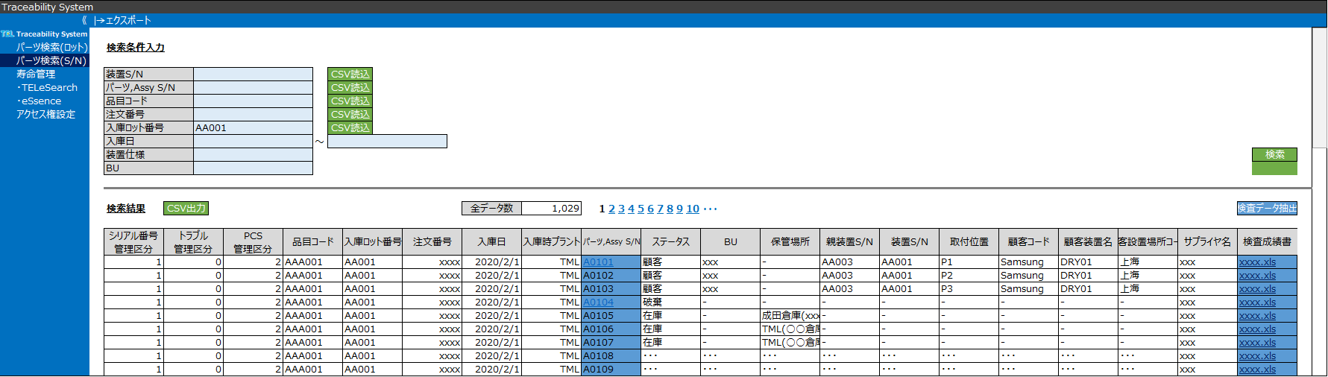
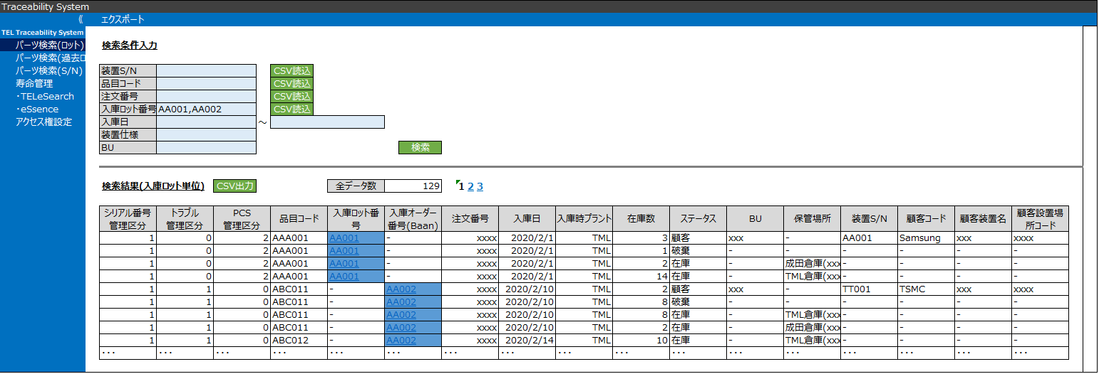
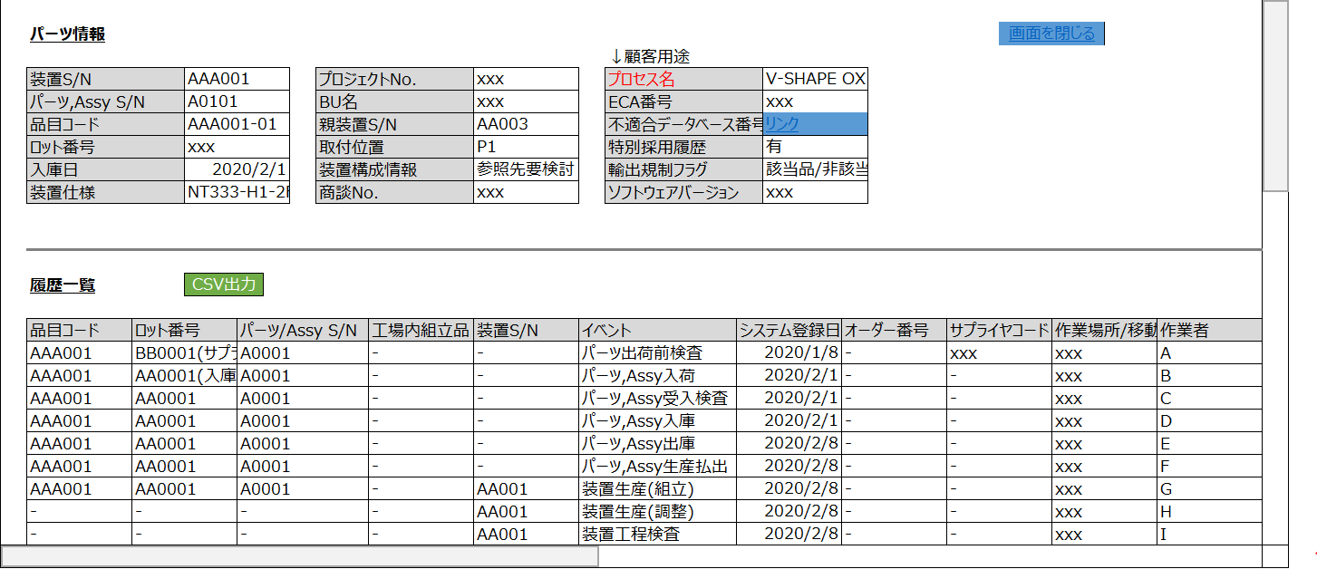
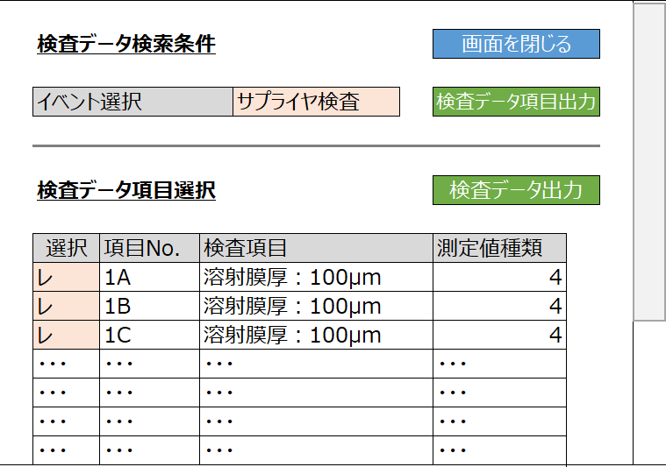
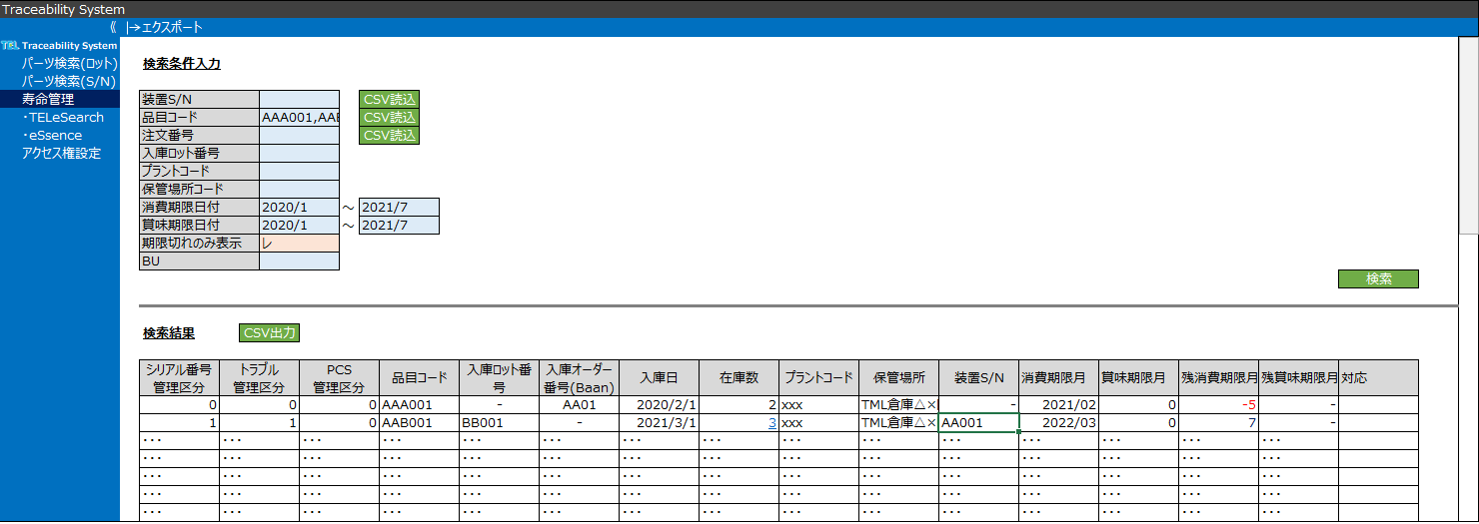
トレーサビリティシステム(照会アプリ) 想定ユースケース
Step1
Step2
Step3
想定ユースケース(照会アプリ画面)
トレーサビリティの役割
1
波及
確認
パーツS/N検索
パーツの所在を確認する
(パーツS/N単位)
Step1
Step2
装置ならびに部品の状態・履歴を即時に特定する
2
品目検索(※)
パーツの所在を確認する
(入庫ロット単位)
不具合部品ならびに波及装置の所在を即時に特定する
3
履歴
調査
履歴調査
パーツの経歴を確認する
4
検査データ
パーツ検査
パーツのサプライヤ検査データを抽出・確認する
パーツ検査データを即時に提供する
5
装置検査データ
装置出荷検査データを抽出・確認する
保管寿命に起因したトラブルを未然に予防する
6
保管
寿命
管理
在庫パーツ
在庫パーツの保管寿命を確認する(入庫ロット、パーツS/N単位)
7
在庫装置
在庫装置に組付けられたパーツの寿命を確認する
※トレーサビリティ対象品以外の全パーツ品目で検索可能とする
(ただし、情報の詳細度は異なる)
2021/12/27時点画面イメージ

Slide 33
Step1/2トレーサビリティシステム 連携全体像
Step1
Step2
Step3
①収集(EAI/ETL)
②格納(DWH)
③照会(パーツトレーサビリティシステム)
多数のデータ発生源システムから、GMXコンテナ、ADPデータレイク、生産コンテナにトレサビの必要データが集められる想定
各コンテナに集められた情報は、トレサビの照会アプリから検索できる形で格納いただく想定
各コンテナの主用途で定めるデータの保持期間から外れる情報は、長期保存コンテナに格納される
各種トレサビデータからパーツの履歴を照会するレポートを構築する
装置構成からのパーツ履歴の誘導、パーツS/Nの変化の追跡などの動きにも対応する
収集
工場SAP
/IPDB
パーツ品目コード情報
Assy品目コード情報
トレサビフラグ5項目
パーツマスター情報
格納
トレサビデータ
照会
トレサビ照会ツール（アプリ）
GMX
※緑字:GMX経由で取得
トレサビ
データマート
FCN・SIパーツ
のトラッキング
問合せパーツ検査結果加工
WISDOM
パーツ
寿命管理
機差
トラブル
装置マスター情報
装置履歴実績
(移設,立下げ等)
Merit21
装置構成
リンク参照
工場装置生産実績
工場パーツ/Assy生産実績
Assyサプライヤ生産実績
工場装置入出荷実績
工場パーツ/ Assy入出荷実績
工場パーツ/ Assy入出庫実績
工場パーツ/ Assy廃棄実績
工場パーツ/ Assy受入検査実績
工場パーツ/Assy/装置在庫情報
トラブル情報(サプライヤ)
トラブル情報(工場)
トラブル情報(工場出荷後)
工場装置生産実績
工場パーツ/Assy生産実績
Assyサプライヤ生産実績
製造時パーツ/Assy廃棄実績
工場パーツ/Assy工程内検査実績
工場パーツ/Assy出荷前検査実績
工場装置工程内検査実績
工場パーツ/ Assy入出荷実績
工場パーツ/ Assy入出庫実績
工場パーツ/Assy在庫
成田パーツ/Assy入出荷実績
成田パーツ/Assy在庫情報
SCM
(特採)
現法パーツ/ Assy入出荷実績
現法パーツ/ Assy廃棄実績
預託パーツ/Assy在庫情報
サプライヤリワーク実績
サプライヤリペア実績
サプライヤオーバーホール実績
工場リワーク実績
工場リペア実績
工場オーバーホール実績
パーツS/N変更実績
各工場
MES
(3システム)
SAP MM
SAP(MM)
パーツ組付実績
パーツ取外実績
Assy組付実績
Assy取外実績
※FEの顧客作業実績
QVICS-i
サプライヤ情報
パーツ検査実績
Assy検査実績
WMS
TEXAS
DB(3システム)
BaaN
(過去データ)
各工場
ローカルシステム(8システム)
EWM
EWM
未確定
(SAP/SMARTS
等検討中)
Service
CRM
TEL e Search

Slide 34
Step1
Step2
Step3
Step1/2パーツトレーサビリティシステム画面イメージ
SAMPLE

Slide 35
SD2002_Inventory management Inventory Shelf-Life (SLED/BBD) Check (1/2)
Inventory Shelf-life (SLED/BBD) Check – Identify SLED/BBD-Expired Parts
The frequency of inventory shelf-life (SLED/BBD) checks and which parts to kept away from the good stock based on their expiration dates will be determined by the local entity.
SLED-Expired
SLED/BBD
Report
A
Start
Export
SLED/BBD
-expired
parts list
Any SLED/BBD
Expired parts?
Yes
Material
Transfer
Expiration
Type
Genpo
Warehouse
PIC
List
/Report
No
B
BBD-Expired
End
Move the expired parts to the non-good stock.
3PL
3PL
Inventory
Movement
Report
completion
System

Slide 36
SD2002_Inventory management Inventory Shelf-Life (SLED/BBD) Check (2/2)
Inventory Shelf-life (SLED/BBD) Check – Identify SLED/BBD-Expired Parts
Physical parts should be processed and disposed at the 3PL warehouse following Genpo’s instructions.
SLED-Expired
A
Disposition
End
Physical parts should be processed and disposed at the 3PL warehouse following Genpo’s instructions.
Genpo
Warehouse
PIC
No
Disposition
End
BBD-Expired
Add to the
buy-back
parts list
BBK
OK?
B
Buy-Back Process
End
Yes
Physical parts should be processed and send back to Japan factories from the 3PL warehouse following Genpo’s instructions.
3PL
System

